Slide 1
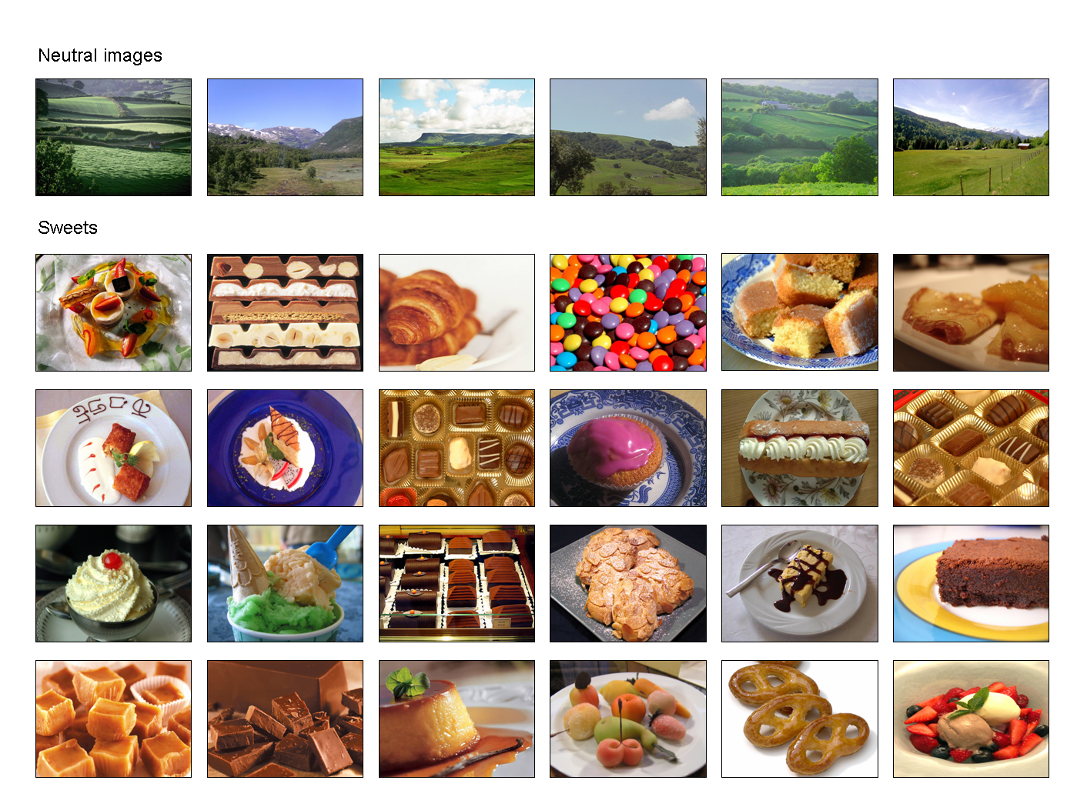
Sweet related visual cue reactivity fades out until adulthood
Daniele Fabio Zullino¹, Emmanuelle Frésard², Riaz Khan¹, Djamel Benguettat¹, Fabian Clays², Yves Montagrin², Farfalla Ribordy², Sophie Taparel², Sonia Krenz², Yasser Khazaal¹
¹Division of Substance Abuse, University Hospitals of Geneva
²Department of Psychiatry, University Hospitals of Lausanne
Introduction
Since Pavlov’s early work, considerable animal and human research has supported the role of conditioning in mediating appetitive reflex modulation and motivation for food intake.
In the addiction literature, numerous studies have demonstrated that exposure to conditioned stimuli associated with drug use leads to conditioned appetitive responses.
Craving for food can be elicited by exposure to food cues (sight, odor, smell, or taste), suggesting that exposure to food cues may represent a useful experimental paradigm to investigate mechanisms related to binge eating.
Skin conductance activity is a sensitive measure of autonomic nervous system activity that correlates well with other physiologic measures and the subject arousal associated with craving. This is due to ability of skin conductance to abruptly rise and fall in response to stimuli (within two seconds delayed peaking in five seconds after presentation of stimulus) and to delayed habituation of skin conductance response to arousal. The objective of the present study was to explore possible factors modulating the cue related psychophysiological reactivity in response to images of sweets
Methods
All 166 volunteers (12 children [age < 12], 48 adolescents [age 12-17], 99 adults [age 18-64], and 7 elderly subjects [age >64]) were recruited during a 7-day scientific exposition for the general public.
Three-minute laboratory session. Participants were first submitted to a 60-second presentation of “neutral” pictures (landscapes), which was followed by a 120-sec presentation of of sweets (i.e. chocolate, soft-ice, cookies etc).
Skin conductance data was collected via a ProComp+/Biograph system (Thought Technology).
Repeated measures GLM were computed. Initial cue reactivity (last 30 sec of the neutral phase vs first 30 sec of the tobacco phase) and habituation (last 30 sec vs first 30 sec of tobacco phase) were defined through contrast calculations
It has previously been suggested that increased SCR recovery time is indicative of a defensive response
Results
BMI, current craving for sweets (VAS scale), hunger (VAS) and time since the last meal were without effect on the reactivity
The effect of the factor “age class” was significant with regard to the initial cue reactivity (F(3)=5.52; p=0.001) and habituation (F(3)=5.25; p=0.002).
The contrasts between the children and each of the 3 other age groups were significant (for all contrasts p<0.005)
Discussion
Experimental paradigms including psychophysiological measures may be less less susceptible to artifact than those based solely on self-reports.
While previous dat has shown that people with restrained eating habits are more likely to overeat after exposure to an external food cue¹, there was no effect on psychophysiological reactivity in the present study. This may confirm an older study that found no differential reactivity (heart rate, temperature, and EMG on frontalis muscle) between obese and normal-weight subjects during presentation food stimuli². Thus, restrained and unrestrained eaters may differ in their craving for palatable foods, but may like them to the same extent³.
Considering the possibility that the reactivity reflects the pleasurable aspect of the stimulus-reaction complex, it can be hypothesized on the basis of the present results that children may experience more vividly and possibly with more pleasurable anticipation the experience.
References
Fedoroff IDC, Polivy J, Herman CP. The Effect of Pre-exposure to Food Cues on the Eating Behavior of Restrained and Unrestrained Eaters. Appetite 1997;28(1):33.
Gardner RM, Espinoza T, Martinez R. Physiological responses of obese subjects to external stimuli. Percept Mot Skills 1988;66(1):69-70.
Roefs A, Herman CP, MacLeod CM, Smulders FTY, Jansen A. At first sight: how do restrained eaters evaluate high-fat palatable foods? Appetite 2005;44(1):103.
ANOVA with repeated measures
10
< 12 years
10
12-17 years
9
8
8
***
*
7
***
6
*
6
5
μS (mean ± SD)
μS (mean ± SD)
4
4
3
2
2
1
0
Baseline
0-30 sec
90-120 sec
0
Baseline
0-30 sec
90-120 sec
10
18-64
10
> 64
9
9
8
***
ns
8
ns
ns
7
7
6
6
5
5
μS (mean ± SD)
μS (mean ± SD)
4
4
3
3
2
2
1
1
0
Baseline
0-30 sec
90-120 sec
0
Baseline
0-30 sec
90-120 sec
Service d’abus de substances
Département de Psychiatrie
WHO Collaborating Center
for Training and Research in Substance abuse

